Slide 1
NOH THEATRE
Japan

Slide 2
NOH
Noh is a form of Japanese theatre, originating in the 14th Century. The playwright Zeami Motokiyo established Noh by combining theatre with Japanese folk traditions such as the harvest celebrations.
Noh is a combination of speech, song, music and dance. The stories are often based on historical texts and ancient literature, with themes including dreams, ghosts and supernatural events.
Noh is derived from the Japanese word for talent. It is a very traditional form of theatre, and is performed according to many ‘rules’. These include rules for staging, costume, movement, character and Mask. Movement is very stylised and gestures can have symbolic meaning.

Slide 3
THE NOH STAGE
Noh is traditionally performed on a square stage (the hon butai) with four pillars (hashira) supporting a roof. Three sides of the stage are open. Behind the stage is a space called the Ato-Za where the musicians sit. Behind them is the Kgami-ita; a backdrop with an image of a pine tree. SL is an area where the chorus sit (the jiuati-zu)
There is always a bridge or corridor (Hashigokari) which runs off the stage for entrances/exits and additional acting space. This is also decorated with pine trees.
Traditionally a performance lasts all day and consists of five Noh Plays and several shorter Kyogen (comic) pieces. Nowadays it is more usual to show two Noh and one Kyogen play. Performances traditionally took place outdoors although many modern Noh performances use indoor spaces.

Slide 4
THE NOH STAGE

Slide 5
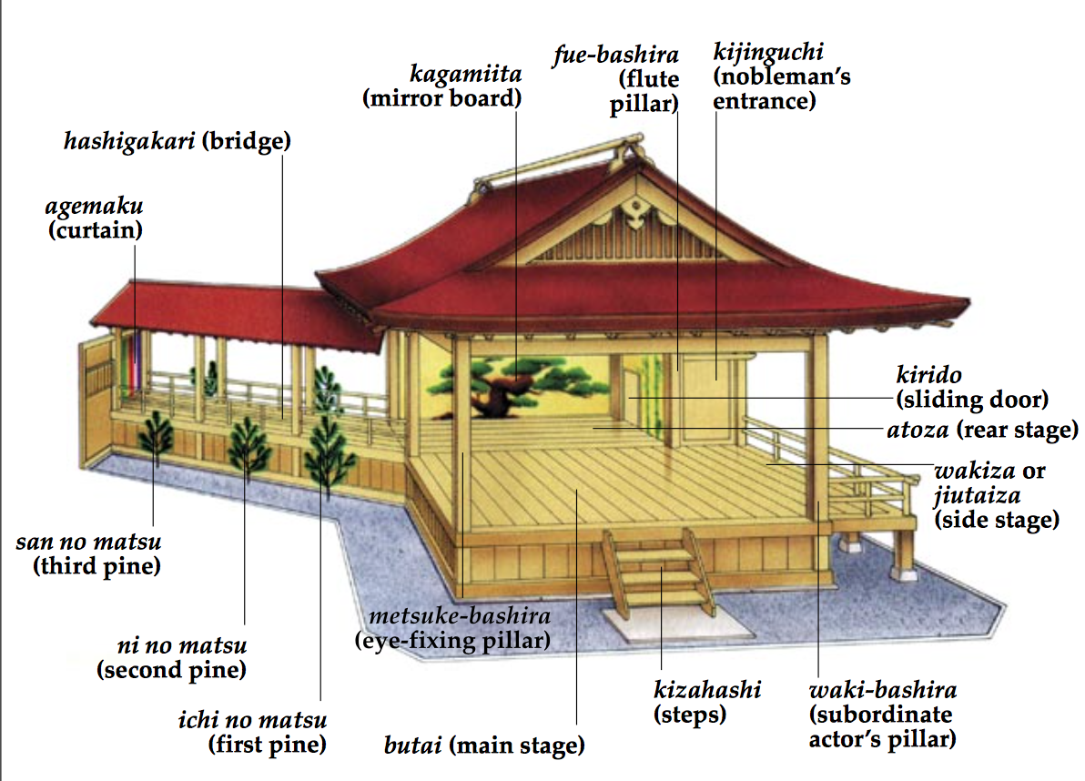
THE NOH STAGE

Slide 6
Noh - the Roles
Traditionally, all actors in Noh Theatre are male. There are five main roles in Noh:
The Shite (pronounced Sh’tay!) - the leading character. Might play a spirit, god or supernatural being.
The Waki - the supporting character. Always plays a human character, such as a priest or samurai
The Tsure - can be the Shitetsure (companion of the Shite, or Wakitsure; companion of the Waki)
Hayashi - the musicians. Traditionally three drummers and a flute player.
Jiutai - the chorus. Usually 8 people. Comments on the action, narrates and describes the mood and thoughts of the Shite
Koken - the stage attendants

Slide 7
NOH MASKS (Omote - Face)
There were originally around 60 types of Noh Masks, today there are more than 200.
Noh actors believe that each Mask has a certain power, and they treat the Masks with absolute respect. The word for the act of putting the Mask on is, ‘kakeru’. The actor ‘becomes’ the Mask and takes on it’s emotions.
Masks are worn to show a wide range of characters including young children, elderly women, demons, gods and ghosts. Only the Shite wears a Mask, the Waki is unmasked as he is always playing a human male.

Slide 8
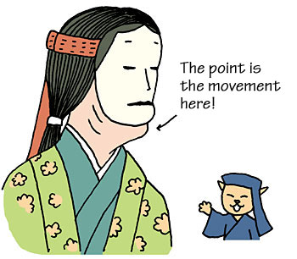
Noh Masks
Noh Masks are very light, and are carved from one piece of cypress wood. Holes are cut for the eyes, nose and mouth and then various materials are used to mould the features. Colours are used that are specific to each Mask.
Some Noh Masks are very special, as they are designed to show different emotions depending on the way the actor tilts his head. This means that one Mask can sometimes be used to show three different emotions.
Noh Masks do not cover the actor’s chin to allow for greater freedom of movement. http://www.the-noh.com/en/trivia/015.html

Slide 9
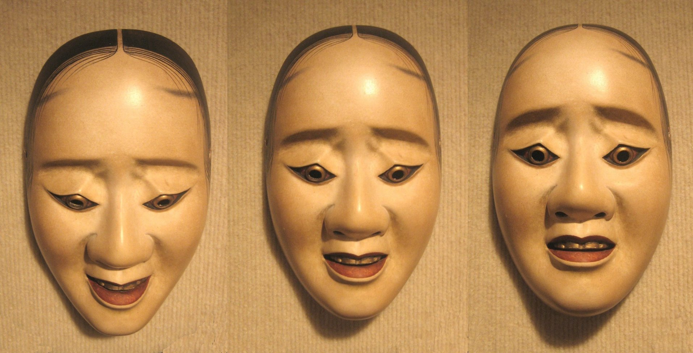
Noh Masks

Slide 10
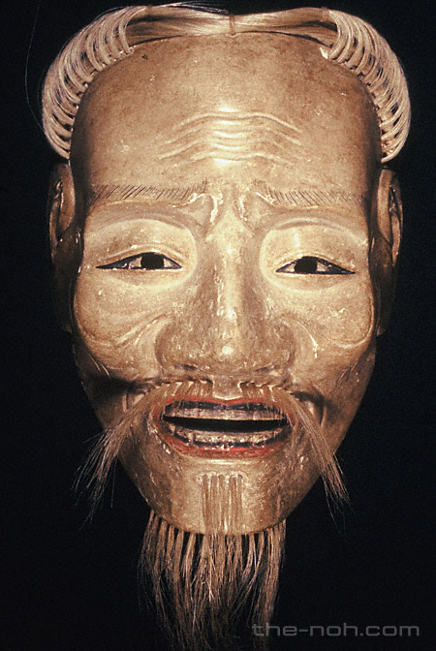
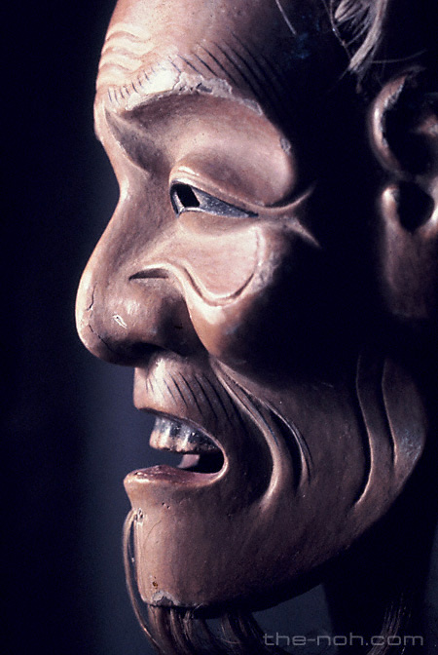
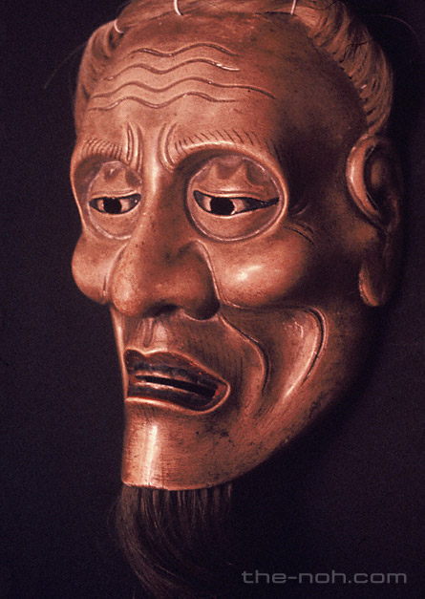
Elder Masks

Slide 11
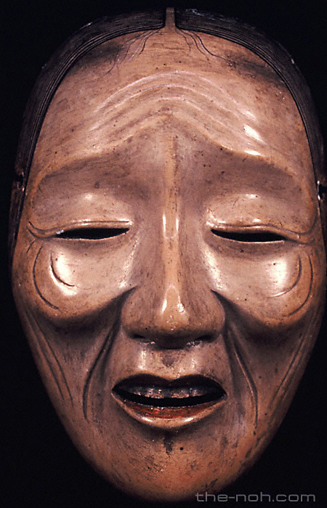
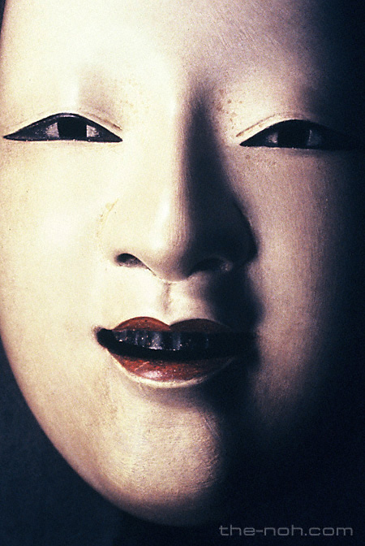
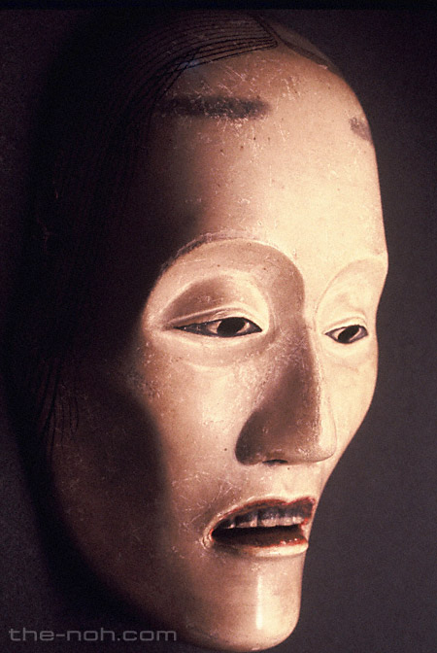
Onna Masks - Female

Slide 12
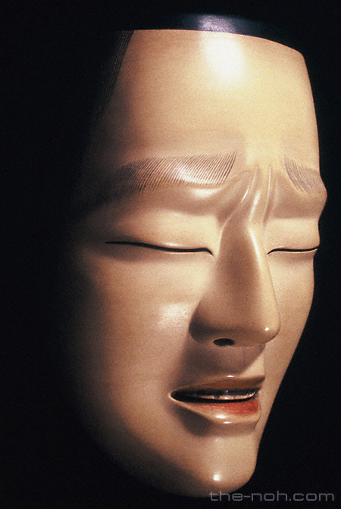
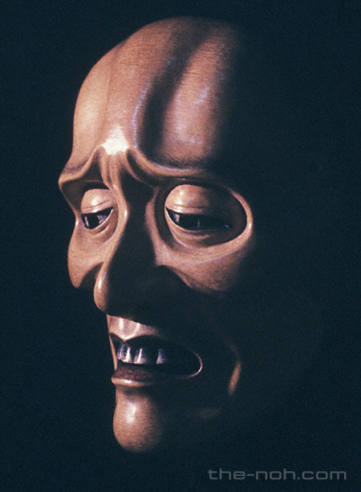
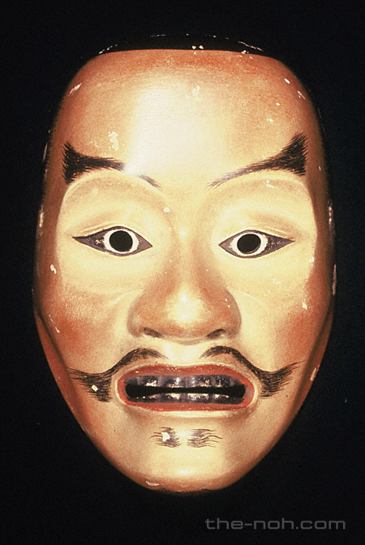
Otoko Masks - Male

Slide 13
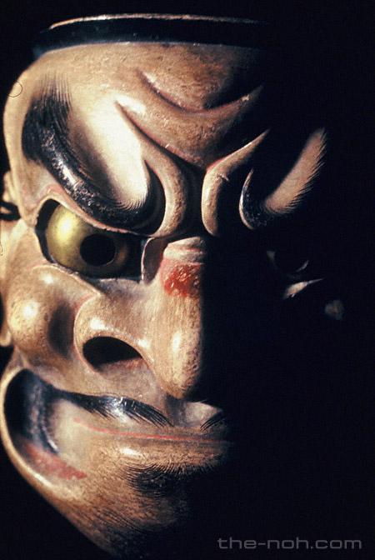
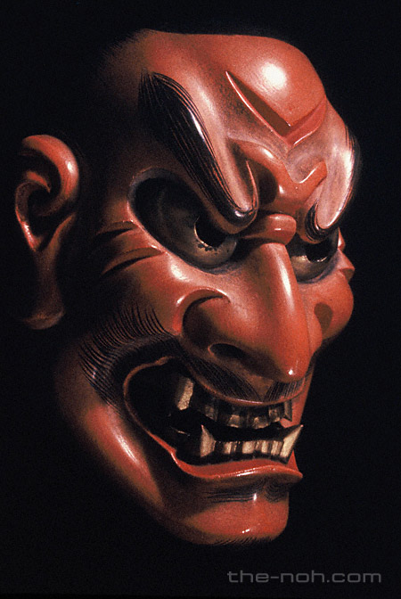
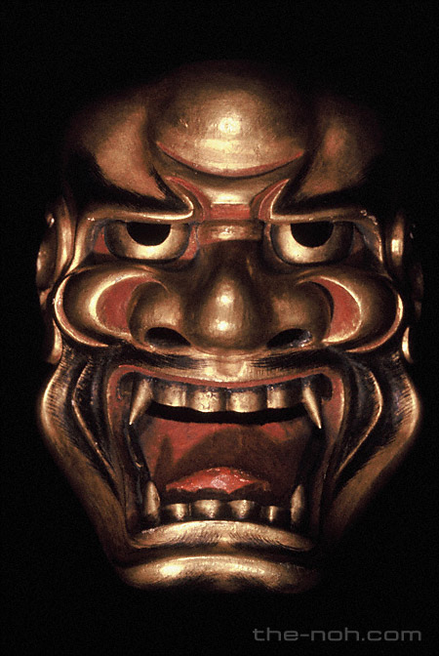
Kishin Masks - Demons

Slide 14
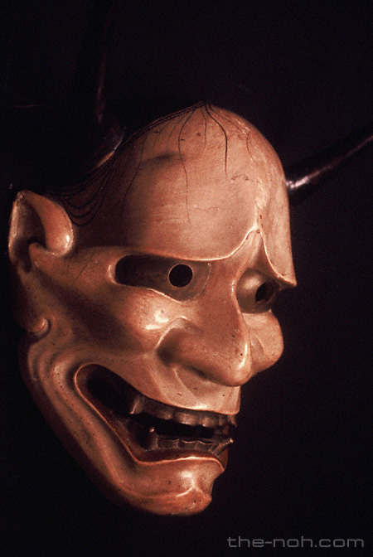
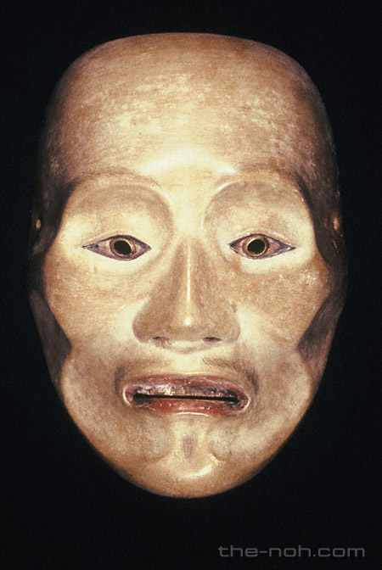
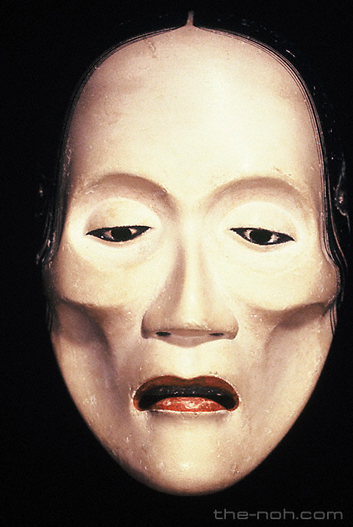
Onryo Masks - Ghosts and Spirits

Slide 15
Costume
Noh costumes are very beautiful, and the audience can tell lots about the character from the colours used. Costumes are divided into 7 sub categories; for more information see
http://www.the-noh.com/en/world/costume.html

Slide 16
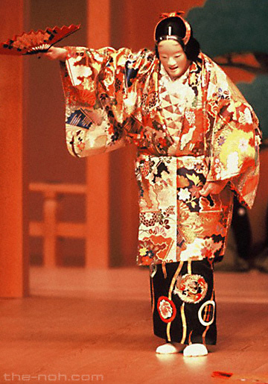
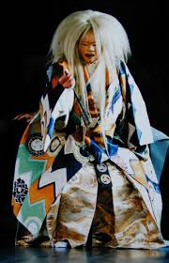
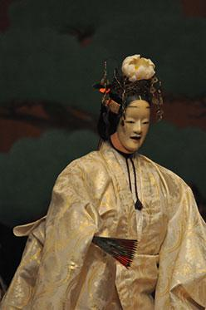
Costume

Slide 17
Sources
All of the Mask images come from this brilliant website:
www.the-noh.com/
Other useful sources include:
http://www2.ntj.jac.go.jp/unesco/noh/en/noh_mask/noh_maskoldman.html
http://www.japan-guide.com/e/e2091.html
http://www.prm.ox.ac.uk/nohmasks.html
http://www.kasrl.org/noh_mask.html
http://www.japan-guide.com/e/e2091.html
http://www.ntj.jac.go.jp/english/schedule/national-noh-theatre.html
http://www.the-noh.com/en/world/

