Slide 1
Masks
Masked Drama from different places and times

Slide 2
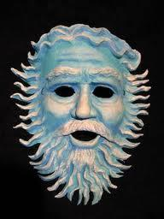
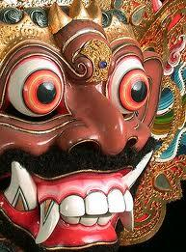
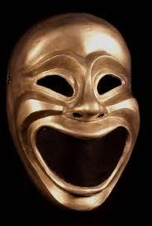
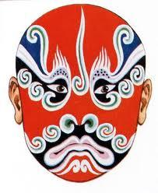
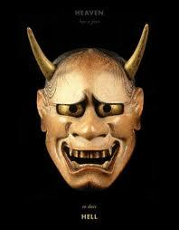
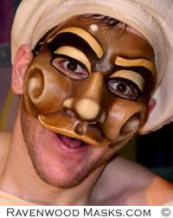
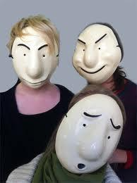
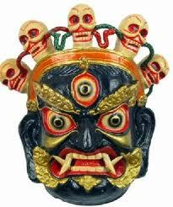
Some Mask Images (all taken from google images)

Slide 3
Masks are important in many cultures from different places and times.
What is a mask?
Why might people wear masks?
What purpose might a mask serve?

Slide 4
A mask is a form of disguise...
It is an object that is frequently worn over or in front of the face to hide the identity of a person and by its own features to establish another being. This essential characteristic of hiding and revealing personalities or moods is common to all masks. As cultural objects they have been used throughout the world in all periods since the Stone Age and have been as varied in appearance as in their use and symbolism.
http://www.anymask.com/historyofmask.html

Slide 5
Masks
Masks have been used for many different purposes over many thousands of years. This is a photo of what is thought to be one of the first ever masks, and it dates from 7000 BC.
http://www.google.co.uk/imgres?hl=en&biw=1517&bih=714&tbm=isch&tbnid=s242AArecOn-WM:&imgrefurl=http://pinterest.com/pattirabbit/masks/&imgurl=http://media-cache-ec4.pinterest.com/upload/140104238377368351_7WVnMtuT_b.jpg&w=192&h=256&ei=hCNDUIzCOuLB0gXhwIHwBg&zoom=1&iact=hc&vpx=206&vpy=203&dur=451&hovh=195&hovw=145&tx=72&ty=79&sig=107309325716018081674&page=1&tbnh=155&tbnw=115&start=0&ndsp=22&ved=1t:429,r:0,s:0,i:72

Slide 6
A mask could be used...
For worship, celebration and ritual, to disguise, to hide behind, to symbolise and signify, to identify, to represent, to intimidate, to indicate social status, for entertainment, to mimic, to make strange..
Can you think of anything to add?
Can a mask transform it's wearer?

Slide 7
Basic Rules for Mask Work
It is important to follow some basic rules for mask work.
Treat your mask with respect
Look at your mask before you put it on. What characteristics does it have? How would this affect your physicality etc?
Don't throw your mask around or drop it on the floor
Turn your back to the audience when you put your mask on

Slide 8
Rules continued...
When you are acting keep the mask facing towards the audience
Clean your mask after you have used it
Don't talk whilst wearing a full face mask

Slide 9
Greek Theatre Masks
It is often said that Theatre grew from religious worship and ritual in Ancient Greece, although many other cultures also held ceremonies and celebrations before then.
One of the gods worshipped in Ancient Greece was Dionysus; the god of festivity and wine. Masks were often used in these festivals, and soon actors began to use them on stage as well.

Slide 10
Greek Masks
Only men were allowed to act, so when there was a female role a mask was worn.
Masks were also used for multi-role-playing.
The features of the mask were exaggerated and showed a character's emotions.
It is also thought that the shape of the mask's mouth helped amplify the actors voice
Masks were usually made from wood, cloth or leather.

Slide 11
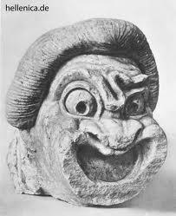
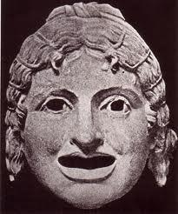
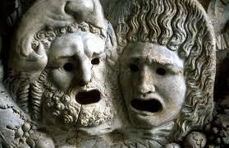
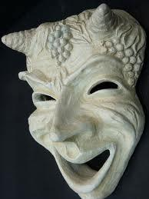
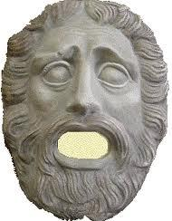
Images of Greek Theatre Masks
(all taken from google images)

Slide 12
Roman Theatre Masks
The Romans also used masks in the theatre.
The features were exaggerated
Masks were colour coded, brown for a male character and white for a female.
Masks showed status, personality and emotion.
There were special masks for comedy and also for tragedies.
Again, masks allowed for multi-role-playing.

Slide 13
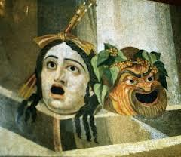
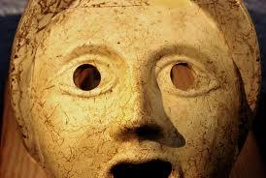
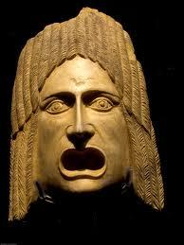
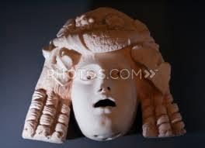
Some images of Roman Theatre Masks...(all taken from google images)

Slide 14
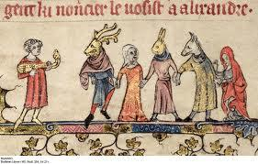
Mystery Plays
Mystery plays were one of the first formally developed forms of Theatre in Medieval Europe. Travelling players acted out morality tales and bible stories in towns and villages.
Masks were used to represent characters such as devils, demons, dragons and other creatures. The mask makers were very inventive and were able to make smoke and steam come out, which must have been quite scary at the time.

Slide 15
Masks for traditional and religious stories in other cultures
Many other countries and cultures have used masks in storytelling.
The Ramayana is the story of the Hindu god Vishnu, who comes to earth as the human prince Rama; sent to kill an evil demon named Ravana.
There are also Thai, Cambodian, Nepalese, Burmese, Balinese, Filipino and Indonesian versions of the tale.

Slide 16
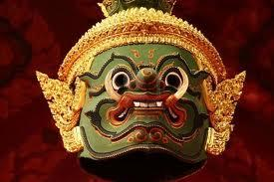
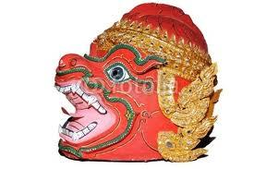
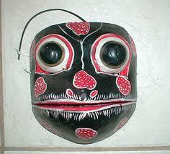
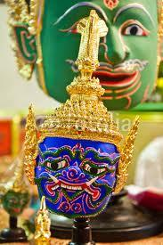
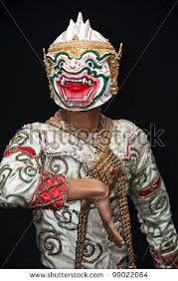
Some Ramayana Masks

Slide 17
Masks in Asia
Asia has a fantastic tradition of masked theatre. Some of these styles feature very detailed make up which is a form of mask. You may wish to explore some of these genres further...
Kolan (Sri Lanka)
Kathakali (Indian)
Kabuki (Japan)
Chinese Opera

Slide 18
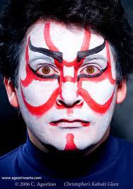
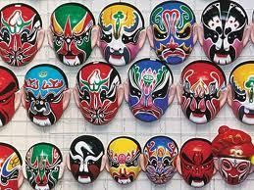
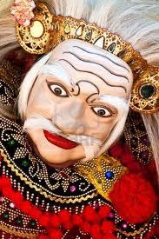
Masks in Asia continued...
Topeng (Bali)
Lakhon (Cambodia)
Buddhist Mask Theatre (various)
Noh (Japan)

Slide 19
Noh Theatre
Noh is a famous form of Japanese theatre. It dates from the 14th century and originated from a combination of Chinese performing arts, Buddhist worship and Japanese dance.
There are several different types of mask in Noh.

Slide 20
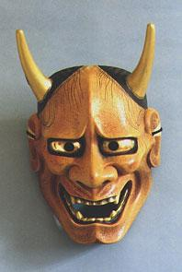
Noh Theatre
The following information comes from http://library.thinkquest.org/05aug/00717/pages/masks.html
This is a Hannya mask.
"The person who wears this mask is supposed to play a jealous and evil woman who has turned into a demon. The pointed horns and the metal eyes and teeth are used to show anger and wrath. The coloring of the masks shows how much passion that certain character has in that demon’s anger."

Slide 21
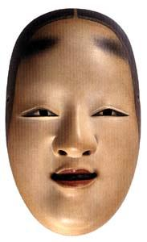
The Ko-omote Mask
This mask represents a young woman who is calm. The Ko-omote mask represents the traditional Heian beauty featuring shaved eyebrows, blackened teeth, and neat hair. Some ko-mote masks have lips that are farther apart and fuller looking cheeks. You can tell how old a character is supposed to be depending on how wide the masks eyes. The ko-mote masks have eyes that are closer together to represent that it is a younger woman.

Slide 22
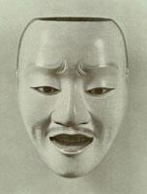
The Otoko Mask
`Otoko masks are the masks that young man wear. There are many different masks that can be used to represent young men. Just like ko-mote masks, the eyes represent how old and wise that character is.

Slide 23
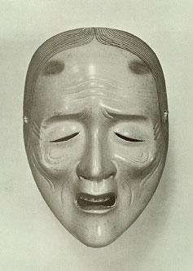
The Uba Mask
"Uba masks were used to represent old woman. An uba mask is usually used in the Noh play Takasago. Woman that wear uba masks are usually shown with a broom and rake. The wrinkles and the gray hair on the mask show that this character has obviously experienced a lot.

Slide 24
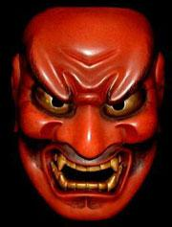
The Shikami Mask
"The shikami masks are used as the demon masks. The fang teeth and the evil looking mouth show the fear that is portrayed in this mask. There is a red complexion on the mask. This shows the anger in the demon just like in the hannya mask. "

Slide 25
Commedia del 'Arte
Commedia is a famous form of Italian improvisational comedy that dates from the 16th century. It is very physical, very fast and very funny. Most actors wear half face masks that represent each stock character, including Arlecchino (a cheeky servant), Il Dottore (the boring, pompous doctor) and Il Capitano (a soldier who brags about everything but is really a coward, scared of the smallest things.)

Slide 26
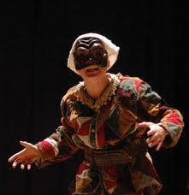
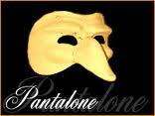
Some Commedia Masks (all taken from google images)
Arlechinno
Pantalone

Slide 27
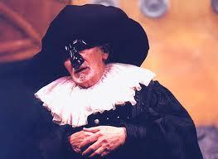
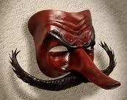
Commedia Masks
Il Dottore
Il Capitano

Slide 28
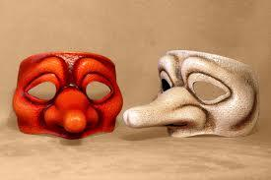
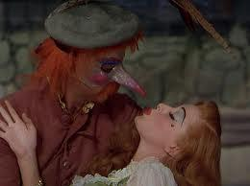
Commedia Masks
Zanni
Scaramouche

Slide 29
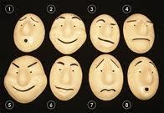
Contemporary Masked Theatre
Many companies still perform using masks today. Some of the most famous European companies are Trestle, Vamos and Strangeface.

Slide 30
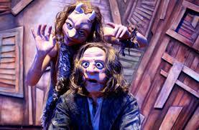
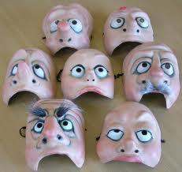
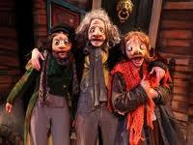
Strangeface Theatre Masks

Slide 31
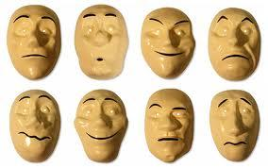
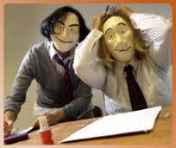
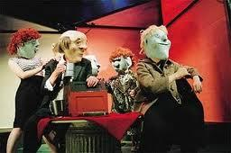
Trestle Theatre Masks

Slide 32
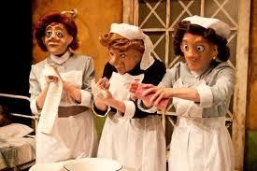
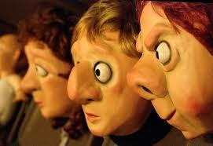
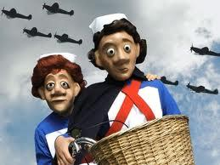
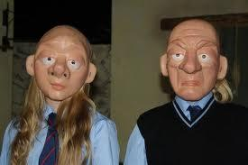
Vamos Theatre Company Masks

Slide 33
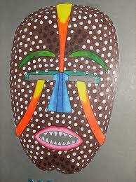
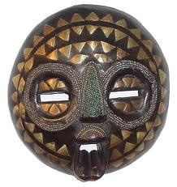
Masks in other cultures, countries and times
Masks are also an important part of the heritage of many groups of people around the world. If you are interested you may want to explore the masks of...
Africa

Slide 34
North America
South America

Slide 35
Australia
New Zealand

Slide 36
Useful websites and bibliography
http://www.anymask.com/historyofmask.html
http://en.wikipedia.org/wiki/Mask
http://www.trestle.org.uk/
http://www.strangeface.co.uk/
http://www.mask-and-more-masks.com/greek-masks.htm
http://www.roman-colosseum.info/roman-life/roman-masks.html
http://www.britannica.com/EBchecked/topic/367906/mask/9063/Theatrical-uses
http://www.mitchellteachers.org/WorldHistory/IndiaUnit/UnderstandingHinduBeliefsRamayana.html
http://www.mask-and-more-masks.com/Asian-Masks.html
http://www.squidoo.com/Ethnicmasks#module1809173
http://library.thinkquest.org/05aug/00717/pages/masks.html
http://www.ravenwoodmasks.com/commedia-mask.htm

