Slide 1
Kabuki
Japan

Slide 2
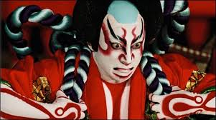
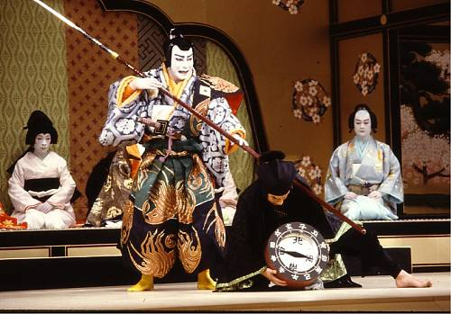
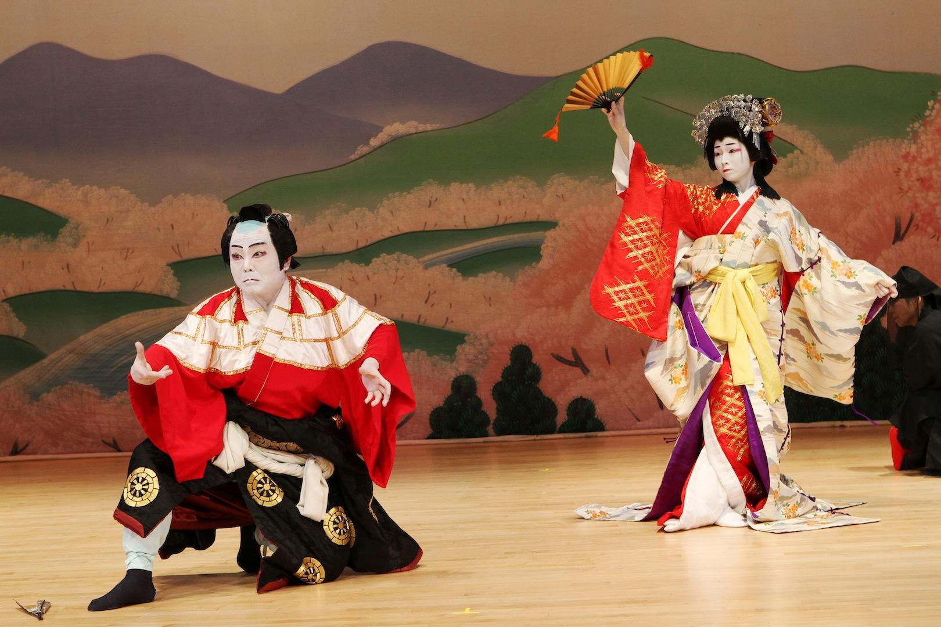

Slide 3
Origins of Kabuki
Kabuki is a form of Japanese Theatre which dates from the early 1600’s. It is a very stylised performance form featuring music, dance and acting, and was based on conventions of Noh Theatre. The movements and gestures of the actors communicate meaning to the audience as do the elaborate costumes and intricate make up. In modern Japanese Kabuki is written with three characters, which translate to Song (Ka) Dance (Bu) Skill (Ki).
Kabuki was a form of entertainment for the people. Before this theatre had been accessible only to the aristocracy. In 1600 the Shogun Tokugawa took control of Japan, and unified the country, bringing a period of peace and prosperity. The economy boomed and for the first time the lower classes had money to spend on entertainment as well.

Slide 4
The Legend of Kabuki
‘In the summer, when the Kamo River in Kyoto shrank to a small stream, the dry riverbed near the Gojo Bridge became a place where so-called kawara-kojiki (or river bank beggars) arranged all kinds of entertainment. One such entertainer, as the legend goes, was a Shinto priestess named Okuni, who began to dance for passers by. Okuni's dances are heralded as the birth of kabuki, and although her performances may have had a religious origin, she soon had many imitators, and these entertainments developed into more risque performances. (Woods)
At this point, Kabuki actors were exclusively women, and they played both male and female roles. The plays were comedies about day to day life, and often touched upon risky themes with lots of sexual suggestiveness. Many of the actresses also worked as prostitutes. Between 1615 and 1623, numerous officially licensed theatres opened, often in the red light districts of cities. They were true ‘melting pots’ of people from different backgrounds and highly fashionable places to be seen. The government became uneasy about the ‘risky’ themes explored in performance and the associations with prostitution, especially when regular fights broke out over who would get to take the more popular performers home at the end of the evening. By 1629 female actors were banned from Kabuki.

Slide 5
The rise of the Onnagata and government control
After the ban on female performers, groups of adolescent male performers (the Wakasu Kabuki) started to incorporate the women’s dances into their shows. Male actors who specialised in playing female roles (the Onnagata) also became popular. However the problems with prostitution and fighting still continued as these actors proved as popular as the women had. At certain points the government banned the Wakasu, and 1652 saw the introduction of Yaro Kabuki - the all male adult cast. The government fought to ‘clean up’ Kabuki, by attempting to remove ‘immoral’ elements of the plays that have been described as, ‘irregular, racy, violent, and, at times, sensational and cheap’ (Woods)
Onna Kabuki - Female Kabuki
Wakasu Kabuki - Adolescent Boy Kabuki
Yaro Kabuki - All Male Kabuki
Onnagata - Male actor specialised in playing female roles

Slide 6
Stylising an Artform
In their attempts to control Kabuki, the Japanese government (the Bakufu) began to create a strict series of ‘rules’ for performance. They wanted to stamp out subversive plots and immoral behaviour but they also went so far as to regulate the building of theatres and even the types of material used in making costumes. Although some resent this as interference others claim it was a prime factor in the development of Kabuki as an art form.
‘The bakufu must be given credit for accelerating or even causing the turn from vaudeville and burlesque toward dramatic art, from one-act dance pieces at best toward dramatically structured plays of five acts or more.’ (Shively)
This transition period took quite a while, and it was not until ‘The Golden Age’ (1673-1841) that Kabuki became fully formalised.

Slide 7
Some background information
Kabuki actors often come from families that have performed for many generations. Traditionally acting skills were passed down from parents to children, but nowadays the world of Kabuki is more open, and actors can enrol to train in Kabuki in centres including the National Theatre of Japan.
Kabuki is often highly melodramatic and historical. The stories are often familiar to Japanese theatre goers, but the language used is often antiquated and hard to follow (a bit like Shakespeare). The actor’s stylised movements and the costumes and face paint all help to communicate meaning. ‘Earphone’ guides are often available at modern Kabuki shows. Although shows last 4-5 hours you can sometimes buy ‘One Act’ tickets, allowing you to watch only one of the five acts.
The play text/story is often seen as secondary to the acting. The overall visual ‘image’ created is most important. ‘The emphasis of kabuki is on creating a beautiful. actor-based spectacle with larger than life gestures, musical enhancement provided by the accompanying orchestra and highly stylized entrances and exits. Kabuki has been compared to a living woodblock print, in that each moment of a kabuki play, if frozen, would capture a scene of remarkable beauty.’ (Hays)

Slide 8
Staging
Kabuki staging is very elaborate. The main features include a revolving stage (mawari-butai), the hanamichi (flower path) - a walkway that extends into the audience, the seri - a series of stage traps that raise or lower actors or sets to the stage, and also the chunori - wires used to create the illusion of flying. These special effects combined with other practices are known as Keren - stagecraft tricks. A short video clip of chunori in action can be found on this page:
http://www2.ntj.jac.go.jp/unesco/kabuki/en/4/4_04_02.html
The end of this short clip shows a seri in action!
https://www.youtube.com/watch?v=WRzkMQ2lB7o

Slide 9
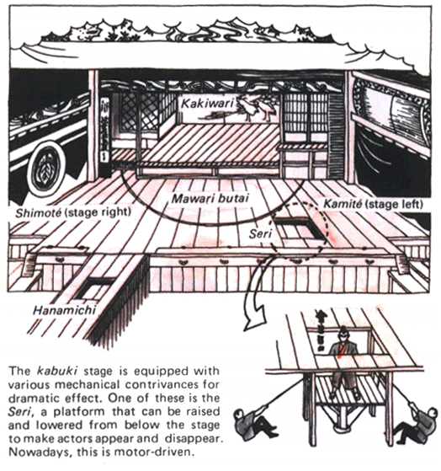
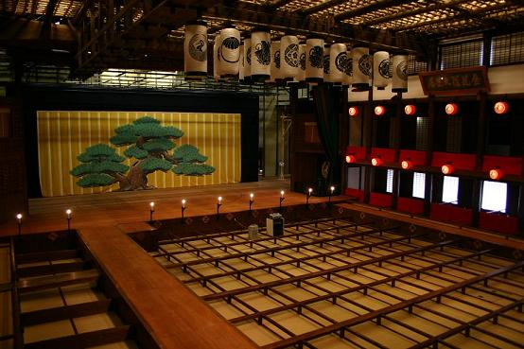
Staging Images

Slide 10
Background Information
There are several types of play performed in Kabuki. The two main categories are the history plays (jidai-mono) and the domestic plays (sewa-mono). The history plays are usually set in the distant past and tell stories of wars and great battles. Characters include samurai, lords, princesses, emperors, servants and supernatural powers. The sewa-mona are slightly more naturalistic, and detail the lives of everyday people. Characters include merchants, prostitutes, families and workers. The plots often explore conflict, duty to one’s family and human emotions such as forbidden love. Other play categories include ghost plays (kaidan-mono) dance-based performances (shosa-goto) and thief plays (Shiranami-mono)
Kabuki plays follow a 5 act structure. The first, ‘Jo’, introduces the characters and plot. The second, third and fourth acts are known as ‘Ha’ - events speed up, there is sometimes a battle, and always a moment of great tragedy or climax. The fifth at is known as ‘Kyu’ is shorter, and concludes the story.
Kabuki features a range of stock characters, similar to many other theatre forms including Commedia, Melodrama and Noh Theatre. These include hero, heroine, villain and young lovers amongst many others.

Slide 11
The ‘Rules’ of Kabuki
Three of the most famous acting styles in Kabuki are Arogoto, Wagoto and Onnagata.
Aragoto is often translated as ‘rough style’ or ‘rough business’ and features exaggerated and dynamic kata (movements) and speech. This is used in history plays, predominantly by the heros and villains. It is also expressed by costume and Kumadori (makeup)
Wagoto can be translated as ‘gentle’ or ‘tender business’ and is a more realistic,gentle and romantic acting style.
Actors often specialise in Aragoto or Wagoto, or in Onnagata.

Slide 12
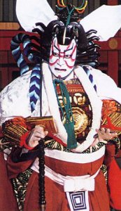
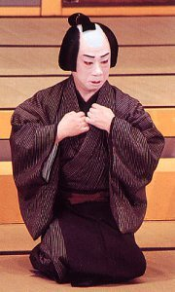
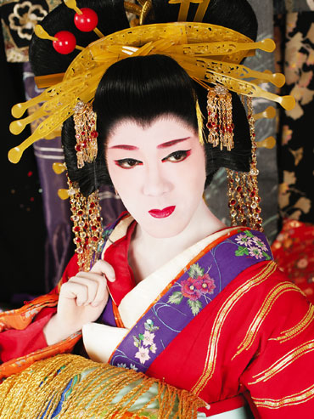
Arogoto, Wagoto and Onnagato
Arogoto Wagoto Onnagato

Slide 13
More on the Onnagata
The Onnagata are male actors who impersonate female characters. Onnagata is also the word for a female role and Tachiyaku is the broad term for a male role.
The Onnagata train for many years to perfect their craft. They do not only use makeup and costume, they also learn to move and speak in ways that give the impression of a woman.
http://www.theguardian.com/stage/video/2010/jun/24/woman-kabuki-theatre

Slide 14
Mie and Kata
Kata are a series of set forms, also found in some martial arts.These include dance-like stylised fighting moves (tate) and special movements for entrances and exits (tanzen and ropo). The climax of any kata is the mie, which can be translated as ‘striking an attitude’.
Mie are powerful poses used in Kabuki to draw attention to an important moment of high emotion. They are typical to the Aragoto style of acting. Remember that Kabuki is primarily concerned with ‘visible beauty’ and so the image is often more important than the speech. There are many standardised Mie that show different emotions and are often associated with specific characters.

Slide 15
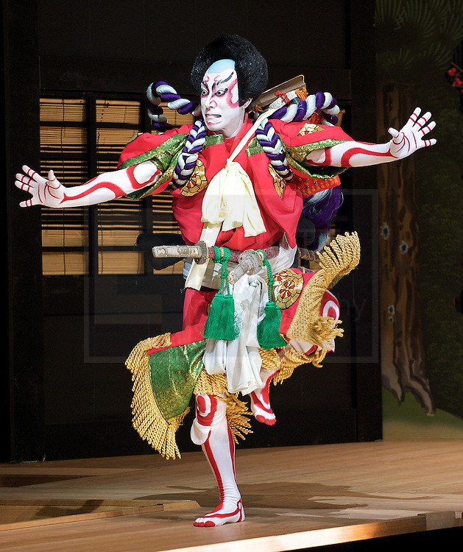
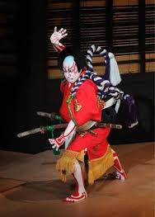
Mie

Slide 16
Transformational Makeup
‘The metamorphosis of a Kabuki actor begins in his make-up. They call it ‘face making’ or ‘face preparation.' (Morita)
Rather than Masks, Kabuki actors use makeup to transform them into another being. The general term for Kabuki makeup is Kesho, and Kesho comes in two types; standard makeup applied to most characters and the wonderfully bold and bright Kumadori, used in Arogoto Kabuki for heroes and villains. There are around 100 Kumadori styles, with 15 commonly used today.The actor traditionally applies his own makeup as a part of this process of transformation.
The audience can ‘read’ a Kabuki play through the makeup and costume used. Standard Kesho is generally used in Wagato Kabuki, and also for the Onnigato. A white base is used for all roles. High status characters have pure white make up, lower class characters add a brownish tinge to show they work outside. Samurais have white faces with black brows and red lips. Female characters have delicate features such as small lips, representing ideals of femininity.

Slide 17
Kumadori
Kumadori is where Kabuki makeup gets really expressive. Bright, bold colours and stripes combine with colours to represent characters and their personalities/defining features such as energy and vigour. These lines often deliberately enhance the actor’s facial features and add to his ability to express emotions.
Generally speaking red symbolises ‘good’ and can show virtue, passion or a superhuman power. Blue generally denotes ‘bad’ and can show emotions such as jealousy and fear. Blue around the mouth, or blue veins can also be used to signify a character is a ghost. Brown can also be used to represent selfishness. Greys and browns can be used to show a character is an animal or demon. Brown can also be used to represent selfishness. The colour pink shows youth, or a cheerful personality, light blue or green can represent calm and black can show fear.
http://www.pbslearningmedia.org/resource/jacult.arts.drama.makeup/japanese-culture-kabuki-makeup/
The video on this page shows the process of applying make up.

Slide 18
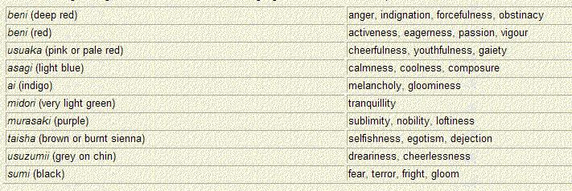
Colour Symbolism in Kabuki

Slide 19
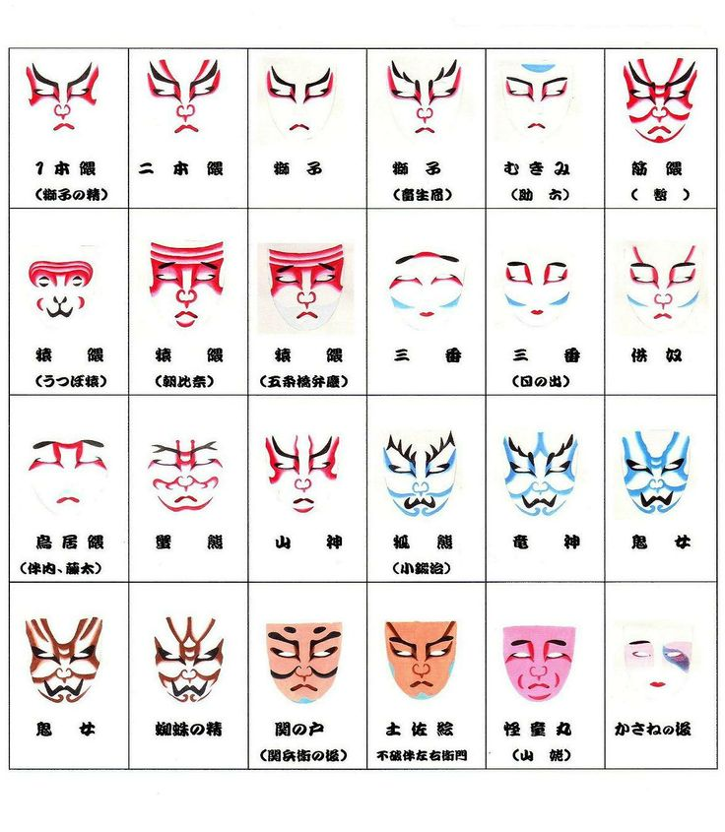
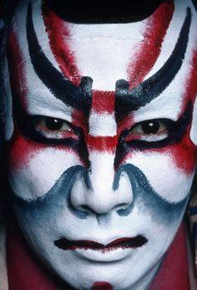
Kumadori Designs

Slide 20
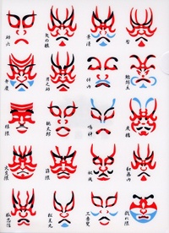
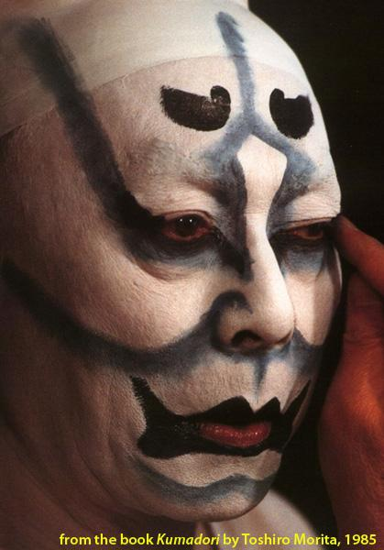
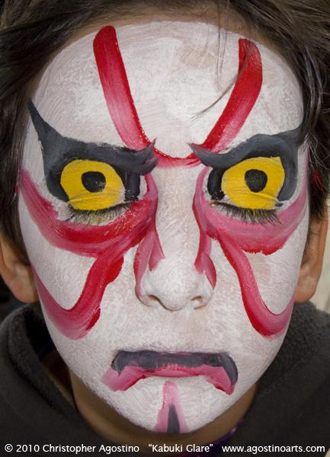
Designs

Slide 21
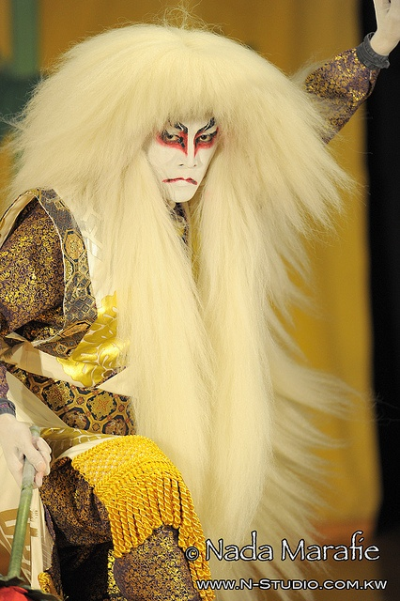
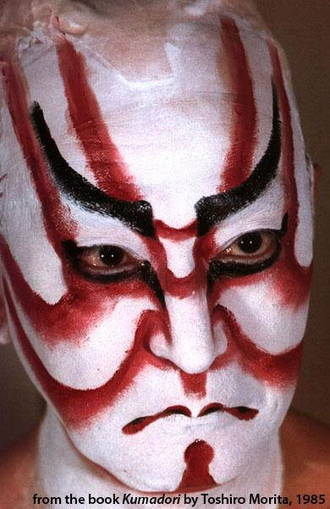
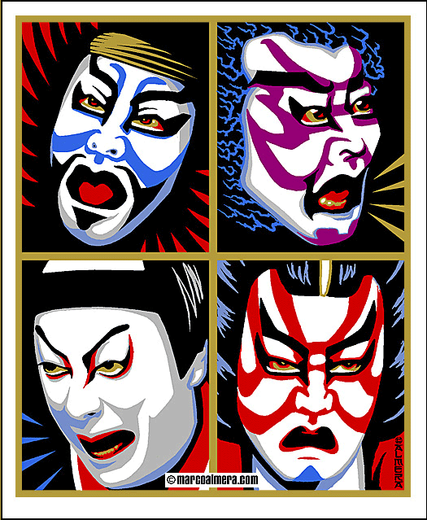
Designs

Slide 22
Costume
Kabuki costumes and wigs are also very detailed and elaborate and represent much about the character wearing them for example their age, status and personality. Colour is again important. Costume changes sometimes take place on stage, to suggest a change in emotion. Stagehands (the Kuroko) assist with the processes of bukkaeri or hikinuki; both of which involve pulling threads that hold the garments together to reveal a different costume underneath. The clip on this page shows hikinuki in action.
http://www2.ntj.jac.go.jp/unesco/kabuki/en/4/4_04_01.html
For much more detailed information on Kabuki costume see the book, ‘The Kabuki Theatre of Japan’ by Aldophe Scott. The book ‘Kabuki Costume’ by Ruth Shaver is also great. The google book links are in the Bibliography.

Slide 23
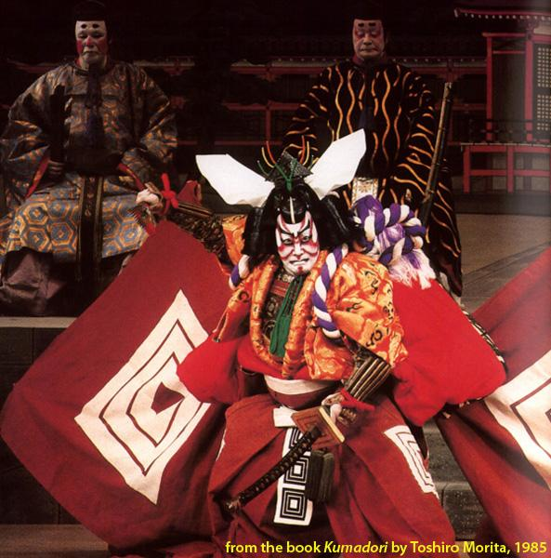
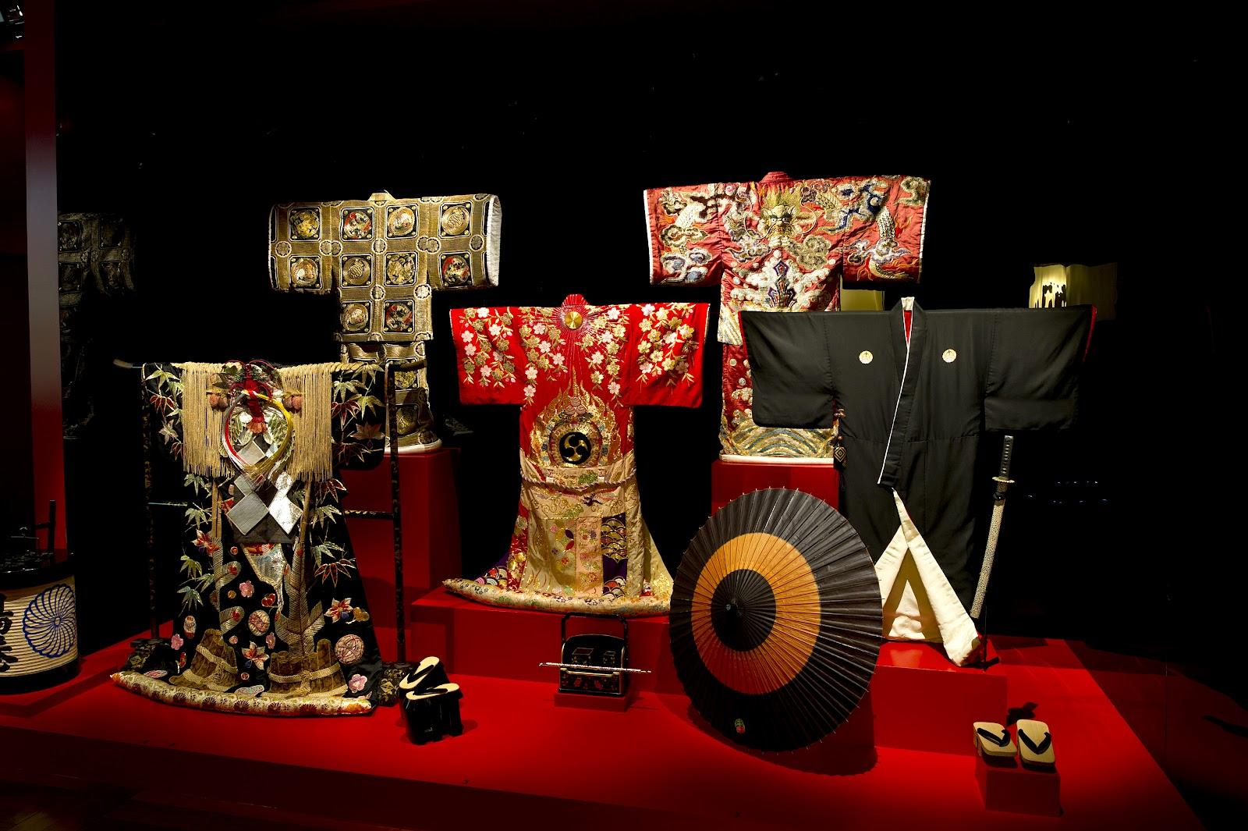
Kabuki Costumes

Slide 24
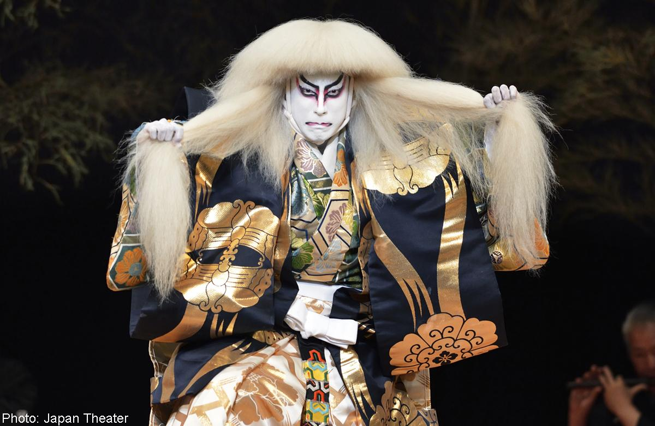
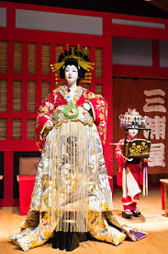
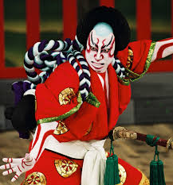
Costume

Slide 25
Kabuki - Transfers, Connections and the Modern Day
The popularity of Kabuki declined during and after WW2. Many theatres were destroyed in the bombings, and Kabuki was banned for a short while by the Allied governments in power as it was thought to be anti-democratic. However, it regained popularity and Kabuki actors were allowed to perform once more. Kabuki is now regarded as a National Treasure of Japan.
The influences of Kabuki can be seen across the globe in theatre, film, Anime and even cartoon - the Power Rangers strike theatrical poses said to be based on Mie. More and more modern actors are also creating new and exciting performance work that appeals to a contemporary audience, based on the great traditions of Kabuki. There is even a variant called ‘Super Kabuki’, popularised by Ichikawa Ennosuke III. This article will tell you more…
http://www.japantimes.co.jp/culture/2014/03/12/stage/super-kabuki-spells-fun/
https://www.youtube.com/watch?v=oidE2SSDczw

Slide 26
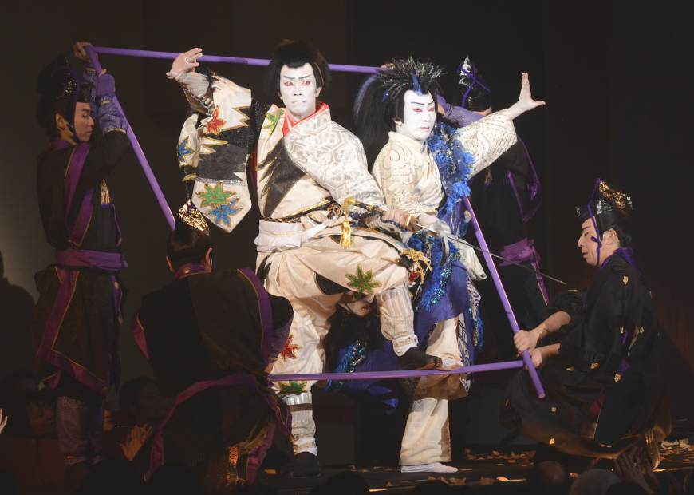
A ‘Super Kabuki’ show - Modern Kabuki

Slide 27
Bibliography and Further Study Sources
Wood, Bethany. "A Brief History of Kabuki - Narukami - The Thunder God." A Brief History of Kabuki - Narukami - The Thunder God. 6 Feb. 2010. Web. 25 Oct. 2015.
Webb, Jay. "KABUKI: HISTORY, THEMES, FAMOUS PLAYS AND COSTUMES." KABUKI: HISTORY, THEMES, FAMOUS PLAYS AND COSTUMES. Web. 25 Oct. 2015.
Unknown. "Japanese Culture - Entertainment - Kabuki Theater." Japanese Culture - Entertainment - Kabuki Theater. Web. 25 Oct. 2015.
Halverson, Megan. "GRAND KABUKI, GRAND STYLE." 1 Sept. 1996. Web. 25 Oct. 2015.
http://www.theguardian.com/stage/video/2010/jun/24/woman-kabuki-theatre
http://www.pbslearningmedia.org/resource/jacult.arts.drama.technique/japanese-culture-kabuki-actors-technique/
http://thestorybehindthefaces.com/2012/01/20/kumadori-japanese-kabuki-theatre-makeup/
https://www.youtube.com/watch?v=oidE2SSDczw
http://web-japan.org/factsheet/en/pdf/e30_kabuki.pdf
https://asiantheatre.wikispaces.com/Costumes+in+Kabuki+by+Alicia+Corts
http://factsanddetails.com/japan/cat20/sub131/item715.html#chapter-5
http://www2.ntj.jac.go.jp/unesco/kabuki/en/4/4_04_01.html

Slide 28
Study Sources continued
https://books.google.com.hk/books?id=Pf3PAgAAQBAJ&pg=PA292&lpg=PA292&dq=kabuki+theatre+costumes&source=bl&ots=DLwFcmt8bw&sig=VYd8If8G1-GyT1AXhTulPZDvjtg&hl=en&sa=X&ved=0CC8Q6AEwBDgUahUKEwiPxuHZs93IAhUhLaYKHUjpCeM#v=onepage&q=kabuki%20theatre%20costumes&f=false
https://books.google.com.hk/books?id=cS6JV4Z27DoC&pg=PA112&lpg=PA112&dq=costumes+in+kabuki+theatre&source=bl&ots=f4rtZi6qD2&sig=GC2RA0gVD6R55r-EDClpIreGOT4&hl=en&sa=X&ved=0CDQQ6AEwBTgKahUKEwiCirH9tN3IAhVDPKYKHef8BiM#v=onepage&q=costumes%20in%20kabuki%20theatre&f=false
https://books.google.com.hk/books?id=68RITdcFpHYC&pg=PA136&lpg=PA136&dq=costumes+in+kabuki+theatre&source=bl&ots=vVGHqaJFMU&sig=cjNRWrtpOqD6nIQGjNXmfc-1_-0&hl=en&sa=X&ved=0CDcQ6AEwBjgKahUKEwiCirH9tN3IAhVDPKYKHef8BiM#v=onepage&q=costumes%20in%20kabuki%20theatre&f=false
http://iis-db.stanford.edu/docs/140/kabuki.pdf
http://www.nytimes.com/1987/07/19/theater/theater-new-look-kabuki.html?pagewanted=all
https://books.google.com.hk/books?id=DrL9AgAAQBAJ&pg=PA26&lpg=PA26&dq=kabuki+influence+modern+theater&source=bl&ots=hRdStDKN-0&sig=1-O-CDn-ANi-9sWjAp6BfJi1-GU&hl=en&sa=X&ved=0CB4Q6AEwATgUahUKEwijjPPVv93IAhVF36YKHUSmB28#v=onepage&q=kabuki%20influence%20modern%20theater&f=false

